Slide 1
Diabetes Data Analysis Using WEKA
By:
Jonathan Kan
Uchenna Onuigbo

Slide 2
Introduction
Objectives:
Introduce the issue of Diabetes
Explain some analytics based on a given sample
Display what we have learned following the WEKA tutorial powerpoint
Exhibit our understanding of the WEKA program with our own interpretations of the data given
Uchenna

Slide 3
What is Diabetes?
Type I
The Immune system attacks the pancreas cells that produce insulin that your body needs.
Type II
The body develops a resistance to insulin, which increases the amount of glucose in the blood to an abnormal level
There is currently no cure for diabetes, but learning more about this disease can get us one step closer to finding the cure.
Uchenna

Slide 4
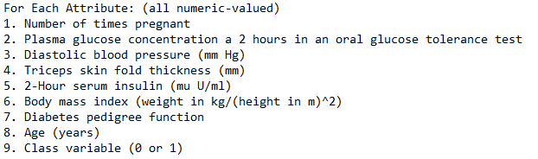
Diabetes Data Categorization
All numeric values are categorized into specific attributes
The unit of measurements are given on the right hand side
Uchenna

Slide 5
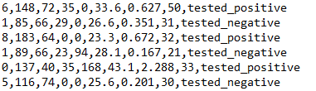
How the diabetes data is stored
Every row represents a tuple of data from different individuals
Each column represents different attributes
Uchenna

Slide 6
WEKA Tutorial Overview and What we Learned

Slide 7
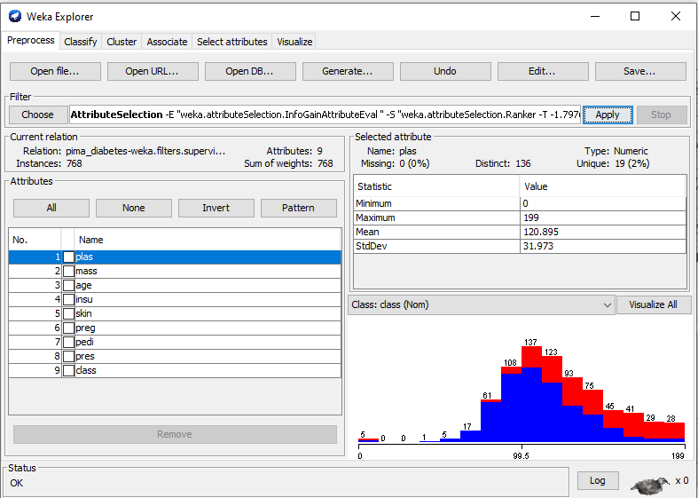
WEKA Tutorial: Ranking System
Using the ranker filter, we can rearrange our attributes from most important to least important
This allows us to narrow down specific impactful visualizations of our data.
Jonathan

Slide 8
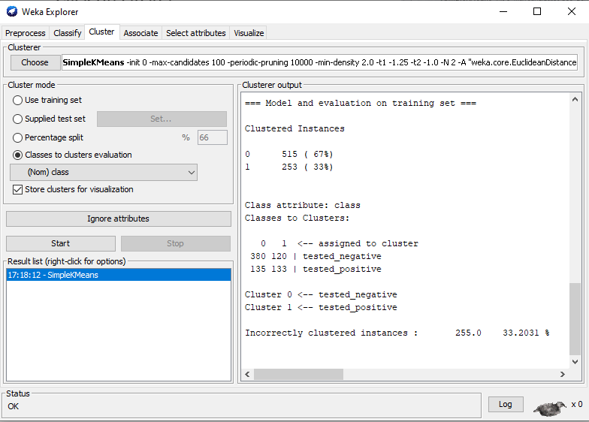
WEKA Tutorial: Clustering
We can cluster our results using the Simple Means cluster algorithm
For the cluster mode we chose class so we can display the positive and negative results
It determined that 255/768 values of the data set were incorrectly clustered
Jonathan

Slide 9
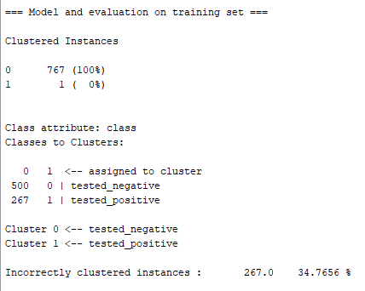
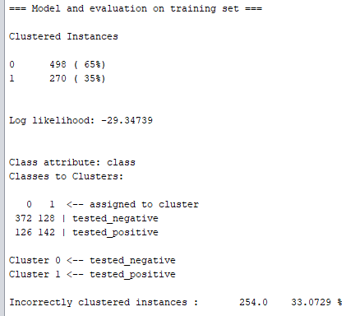
A few other Clustering Examples
Hierarchical Clusterer
Make Density Based Clusterer
Jonathan

Slide 10
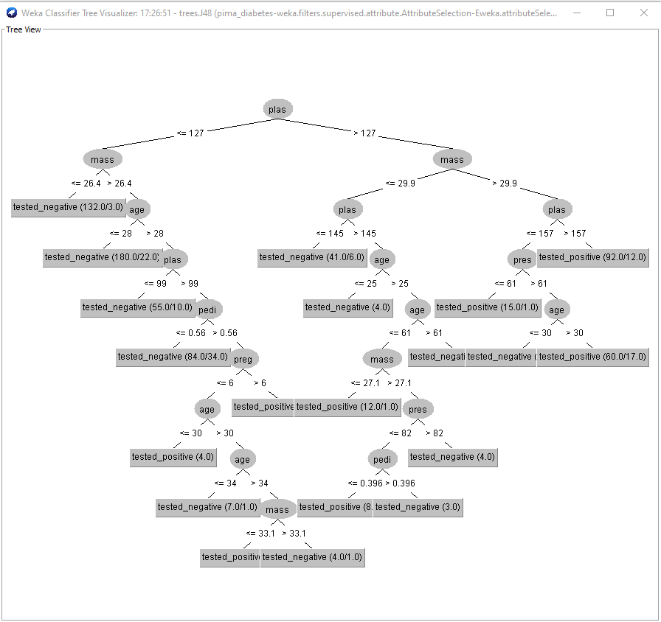
WEKA Tutorial: Trees
Using the J48 Classifier we can formulate a tree based around our data
The tree predicts a positive/negative value based on numeric values and attributes collected from the data set
Jonathan

Slide 11
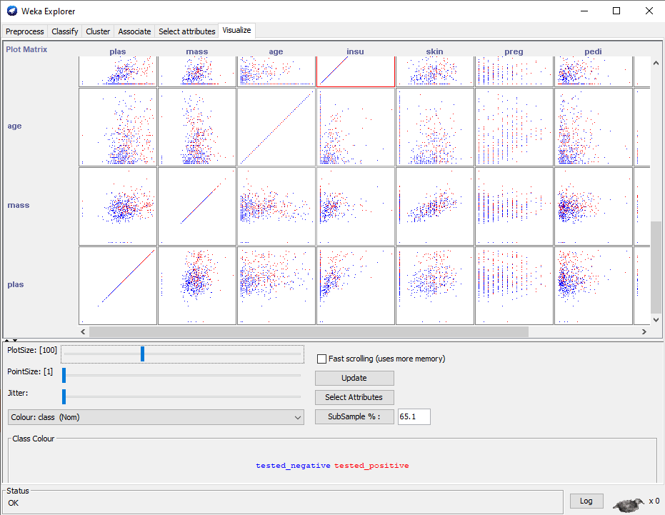
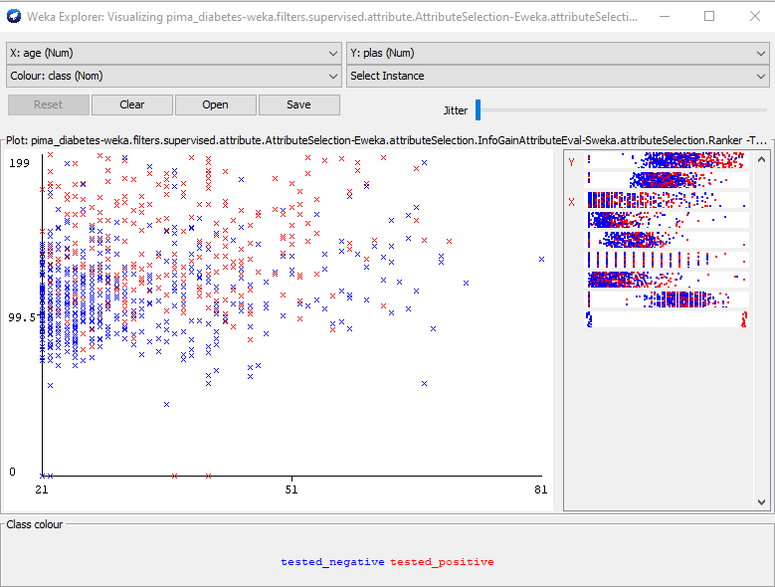
WEKA Tutorial: Visualization
The Visualization function of WEKA allows us to visualize each of our attributes data in a plot matrix
We can also mix and match different attributes to compare which helps visualize any patterns between the two
X: Age
Y: Plas
Jonathan

Slide 12
Our Own Data Analysis Using WEKA

Slide 13
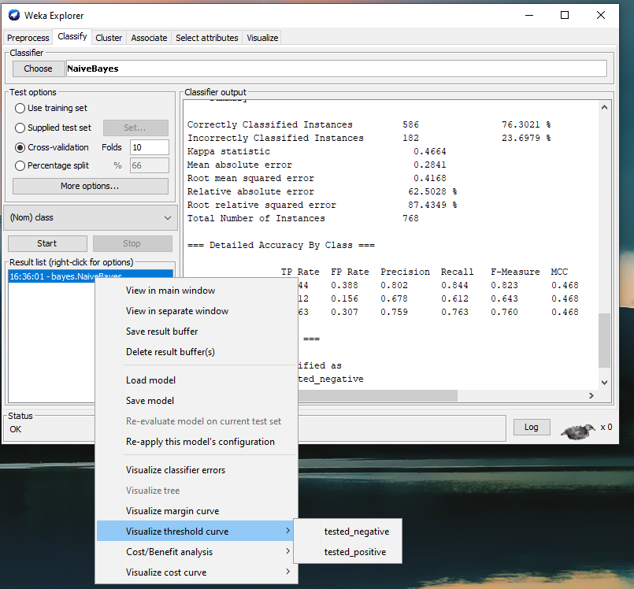
ROC Curve
Receiver operating Characteristic (ROC) curves help predict the probability of certain binary outcomes between 0.0 and 1.0
The ROC curve compares the positive rate against the false positive rate
We will be using the Naive Bayes classifier as it is useful for probabilities
We have an option to produce a ROC curve for both the negative values and the positive values
Jonathan

Slide 14
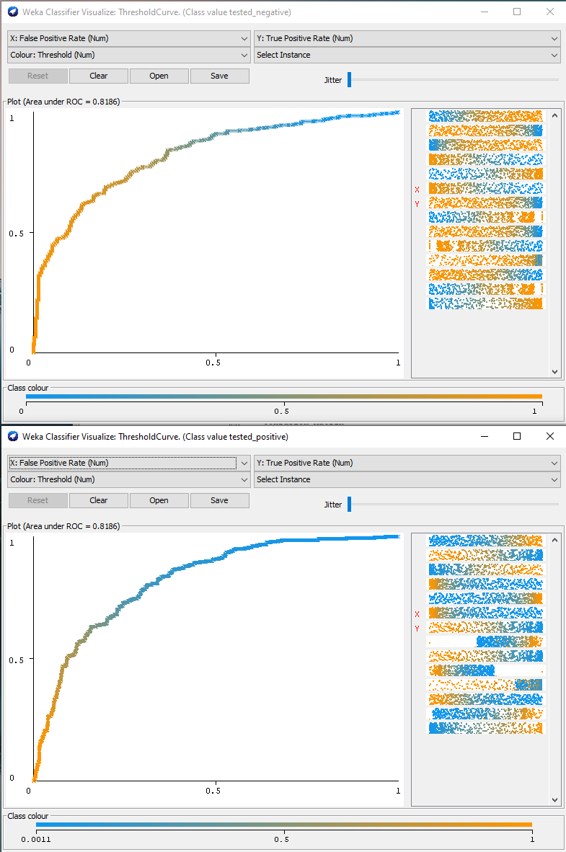
ROC Curve
The top window displays the Negative ROC curve while the bottom shows the positive ROC curve
The closer the arc is to the top left corner, the better the accuracy of the test
If the arc is closer to the 45 degree line, it indicates an inaccurate test
In this case the arc shows a healthy data set
Jonathan

Slide 15
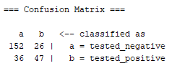
Confusion Matrix
A confusion (error) matrix is a table of predicted and actual values from a classification algorithm
It organizes our predicted outcomes with the expected outcomes
Using the J48 tree classifier, we have
152 true negatives
36 false negatives
26 false positives
47 true positives
Our 2x2 matrix structure
True negative | False positive
False negative | True positive
Uchenna

Slide 16
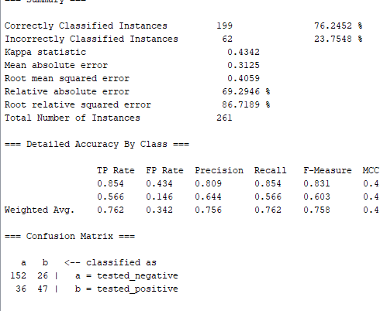
Confusion Matrix
We have 261 test results in total and only 199 results are correct
152 true negative results and 47 true positives
Uchenna

Slide 17
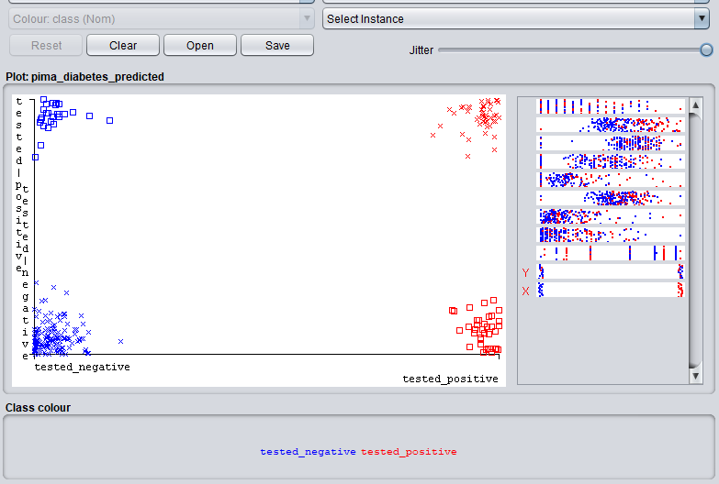
Confusion Matrix - Classifier Errors

Slide 18
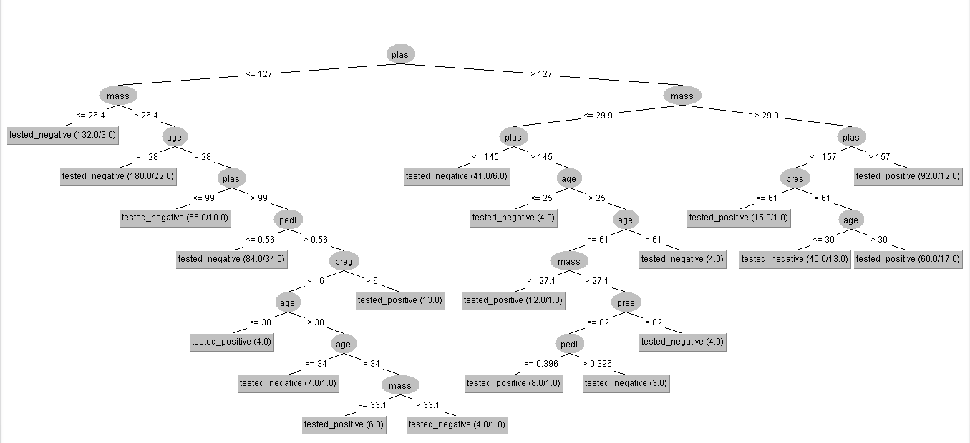
Confusion Matrix: J48 Tree

Slide 19
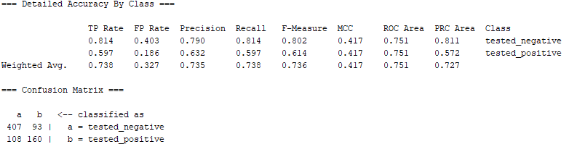
Confusion Matrix: J48

Slide 20
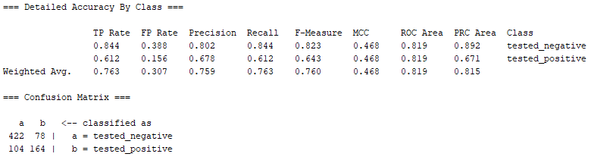
Naive Bayes

Slide 21
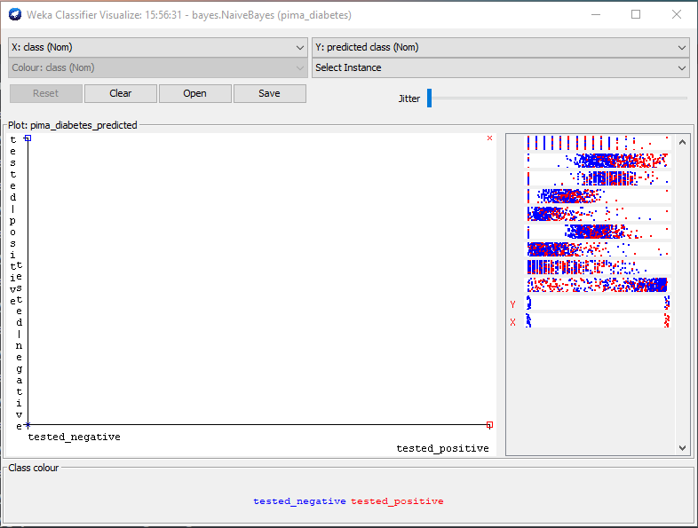
Naive Bayes - Classifier Errors

Slide 22


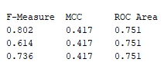

Logistics
J48 Naive Bayes

